Slide 1
Computer Vision

Slide 2
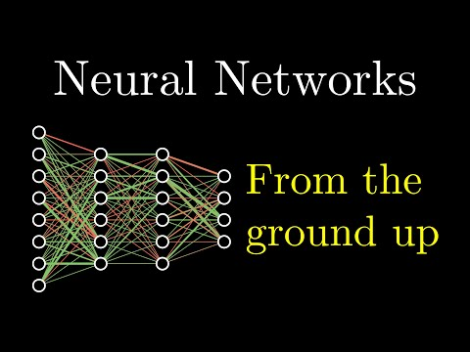

Slide 3
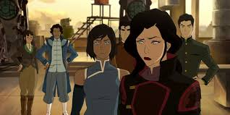
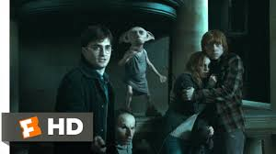


Slide 4
Computer vision: Can we teach computers/machines to do the same?

Slide 5
Representation learning: why, what and how of CNNs
MLP for image processing and classification → Good enough?
Mnist: 28P x 28P = 784P. Iphone 11 pic resolution: Mega-Ps. How big must our neural network be?
Do neighboring pixels have correlations with one another?
Can we represent images better???
YES! CNNs!(convolutional neural networks)

Slide 6
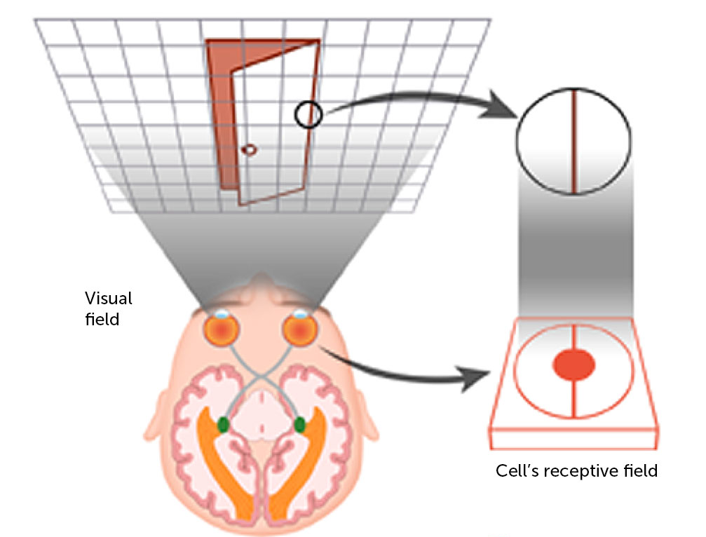
Representation learning: why, what and how of CNNs

Slide 7
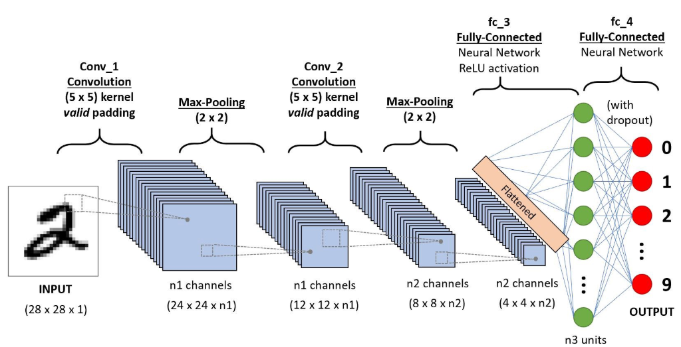
Representation learning: why, what and how of CNNs
2 operations to each convolutional layer: a convolution and a pooling operation

Slide 8
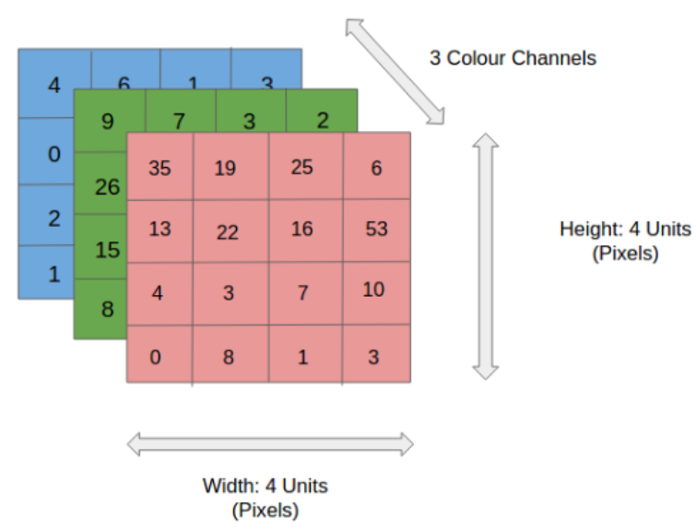
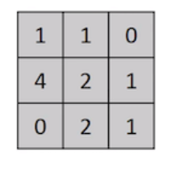
Representation learning: why, what and how of CNNs
Notes:
https://towardsdatascience.com/a-comprehensive-guide-to-convolutional-neural-networks-the-eli5-way-3bd2b1164a53

Slide 9

Representation learning: why, what and how of CNNs
Part 1: The kernel
Feature map

Slide 10

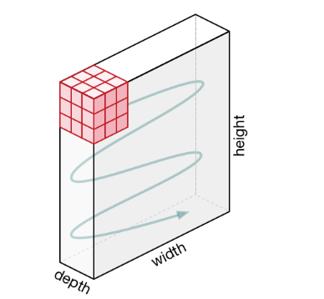
Representation learning: why, what and how of CNNs
Part 1: The kernel
N.B. Zero padding is used here

Slide 11



Slide 12
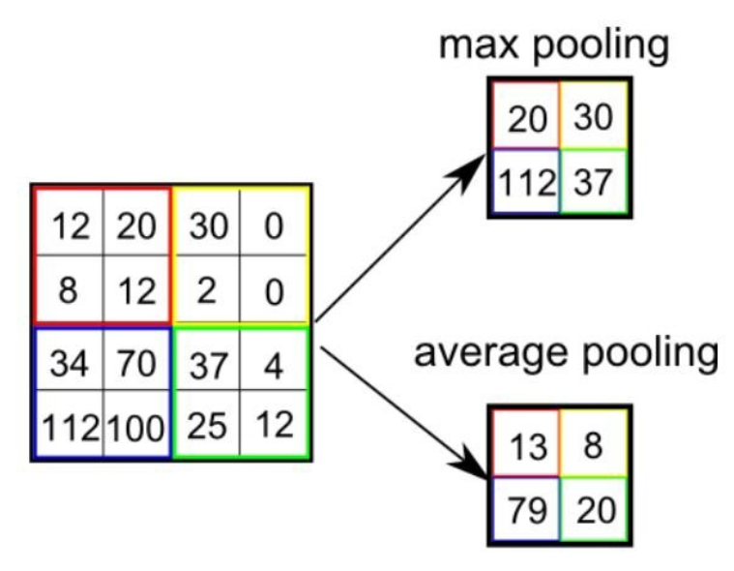

Representation learning: why, what and how of CNNs
Part 2: The pooling layer
N.B. Max pooling is generally better

Slide 13
Representation learning: why, what and how of CNNs
Hyperparameters:
Padding: Same or Valid
Stride length (for both convolution and pooling)
Filter size (for both convolution and pooling)
Number of filters
Pooling: Max or Average

Slide 14
28 x 28 x 1
Kernel convolution with 12 filters, same padding, stride 1, filter size 5 x 5
Putting it together into ONE convolutional layer...
24 x 24 x 12
Activation function (e.g.Relu)
24 x 24 x 12
Max pooling layer of size 2 x 2
12 x 12 x 12

Slide 16
Practice Keras!

Slide 17
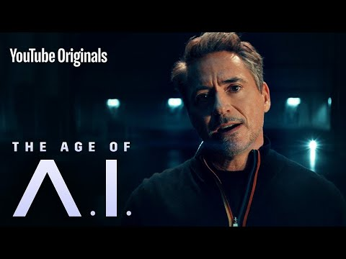

Slide 18
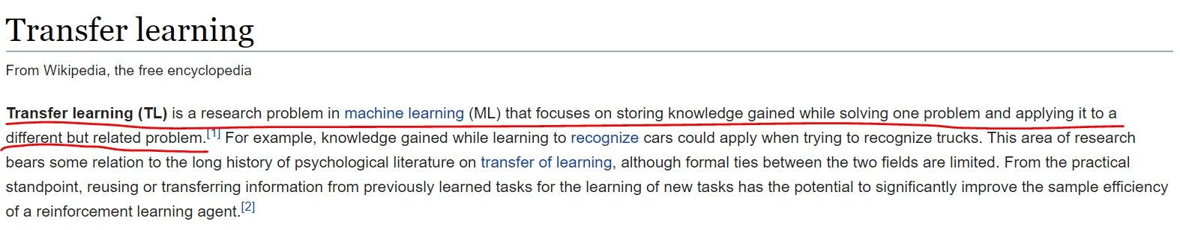
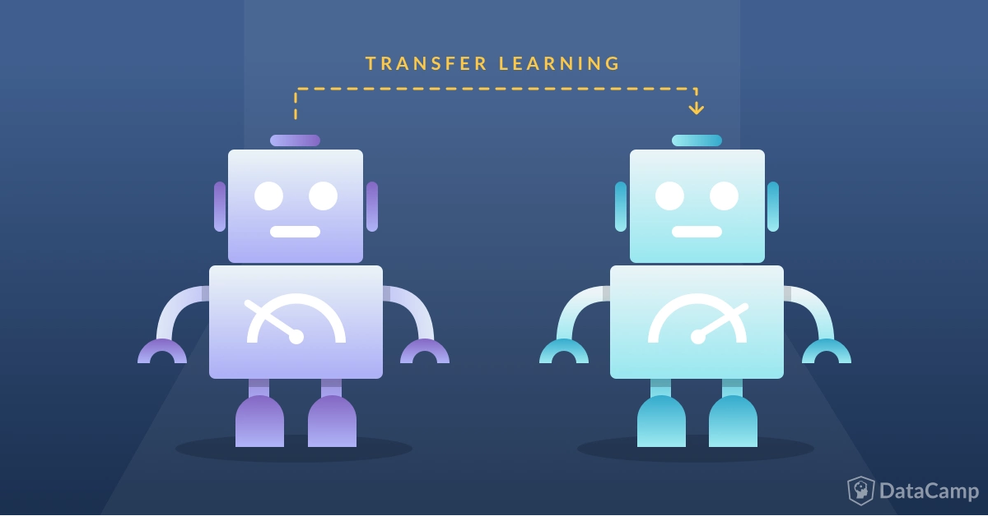
Transfer learning
???
Know how to ride a motorbike ⮫ Learn how to ride a car
Know how to play classic piano ⮫ Learn how to play jazz piano
Know math and statistics ⮫ Learn machine learning
Notes:
https://towardsdatascience.com/a-comprehensive-hands-on-guide-to-transfer-learning-with-real-world-applications-in-deep-learning-212bf3b2f27a
https://www.datacamp.com/community/tutorials/transfer-learning

Slide 19
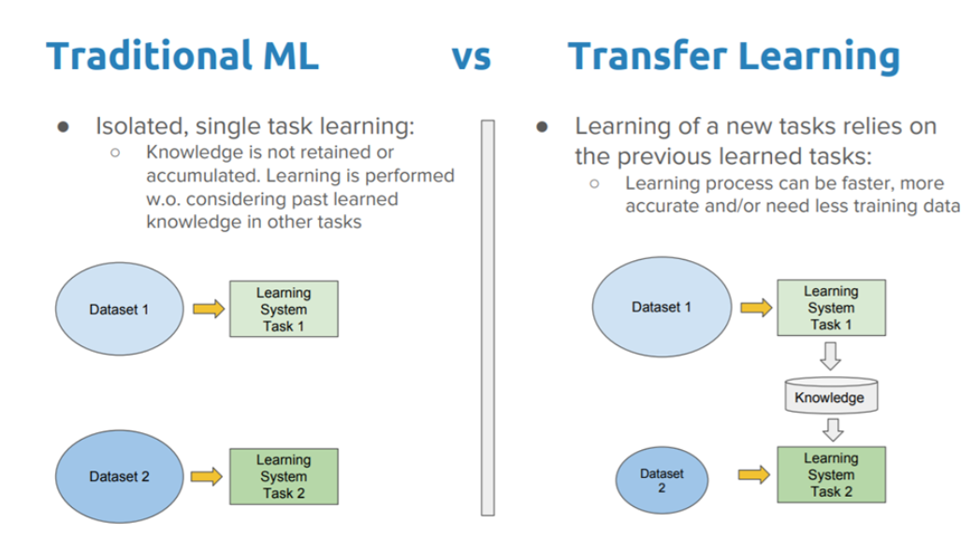
Transfer learning
The general idea of transfer learning is to use knowledge learned from tasks for which a lot of labelled data is available in settings where only little labelled data is available.
Keras provides us with pretrained models that allow for fast and efficient transfer learning!
AlexNet
VGG
Inception
ResNet
MobileNet
Notes:
https://keras.io/applications/
https://cv-tricks.com/cnn/understand-resnet-alexnet-vgg-inception/

Slide 20
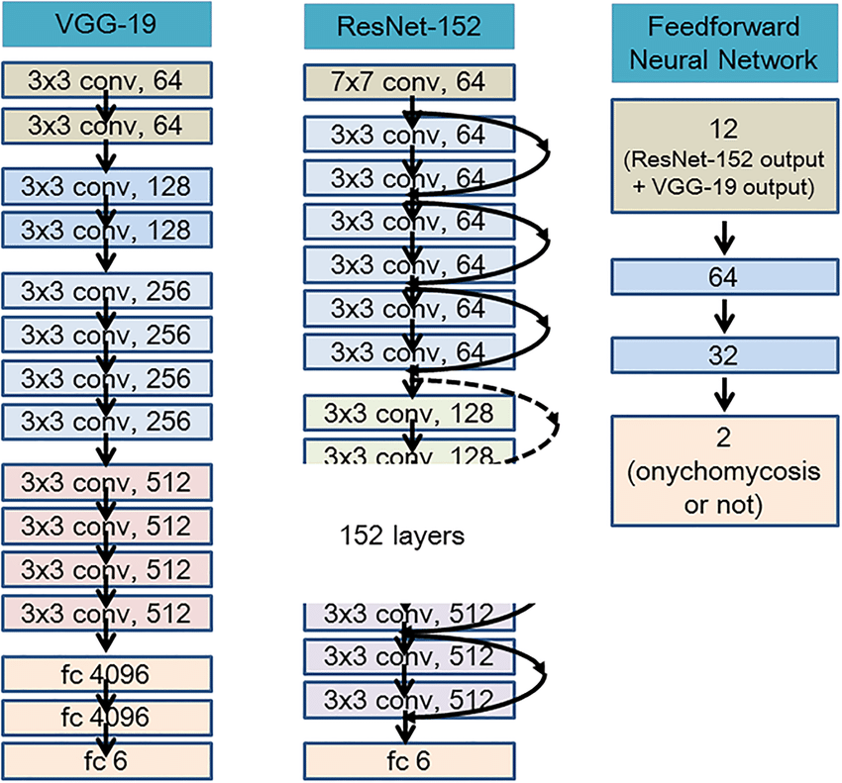

Slide 21
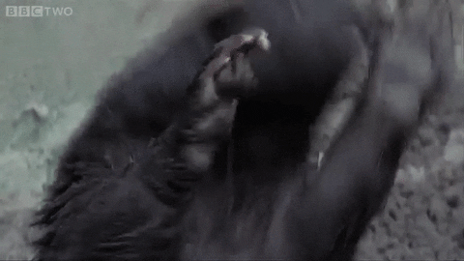
It’s Badger Time!

Slide 22
Situation:
While the entire REP cohort was too busy studying for finals last year, a secret army of mutated badgers escaped from the zoo and infested North Hill! In order to stop them, REPO has enlisted your help in deploying smart cameras in the area to track their movements.
Task:
Develop an algorithm that can help identify and classify these mutated badgers.

Slide 23
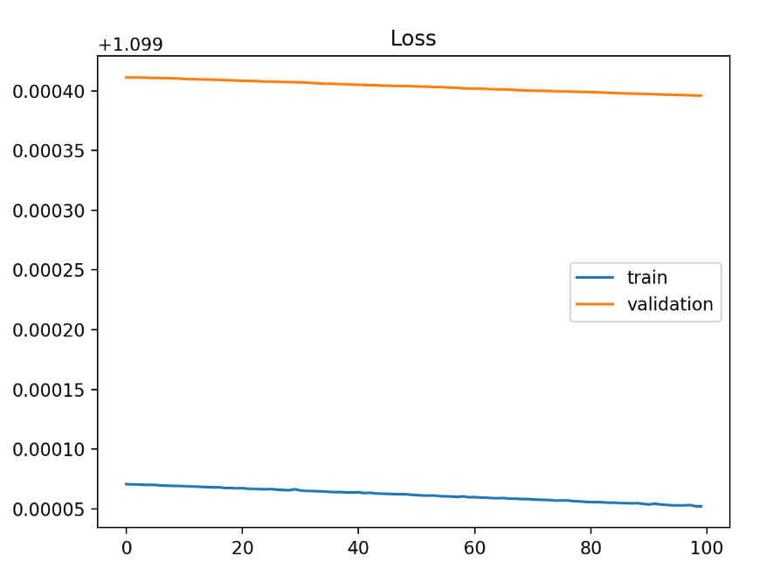
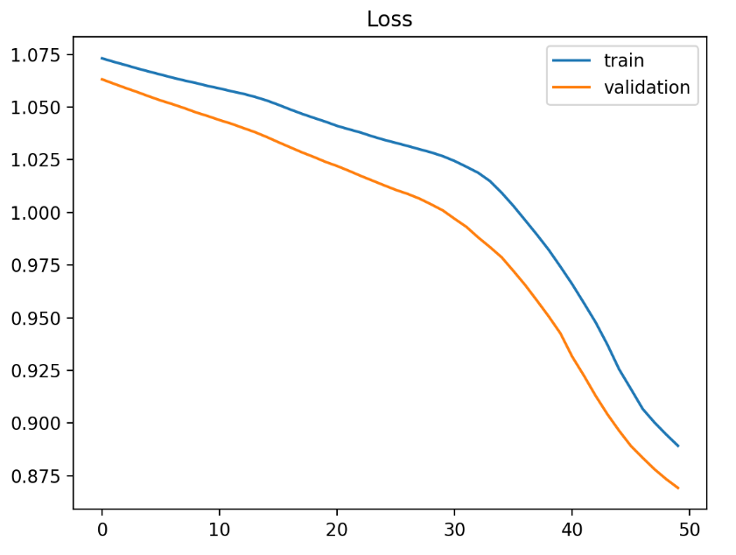
Underfit - cannot learn the training data at all

Slide 24
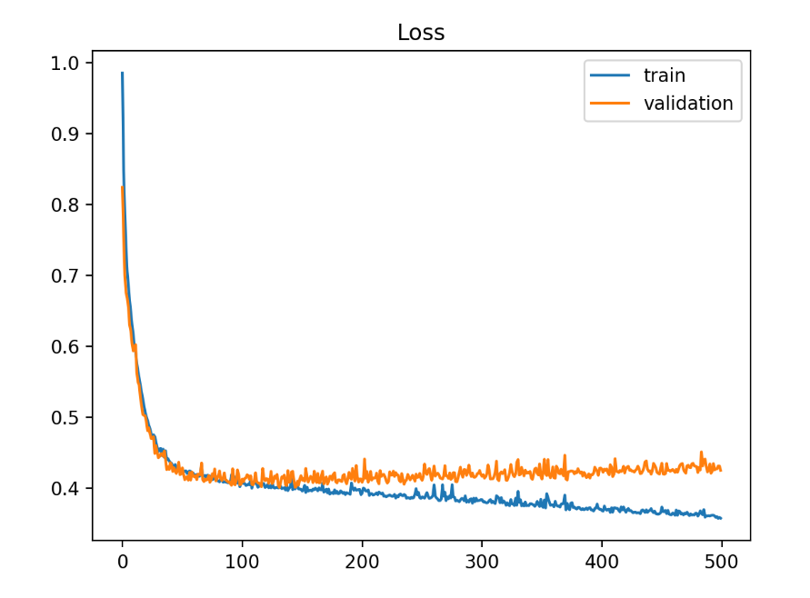
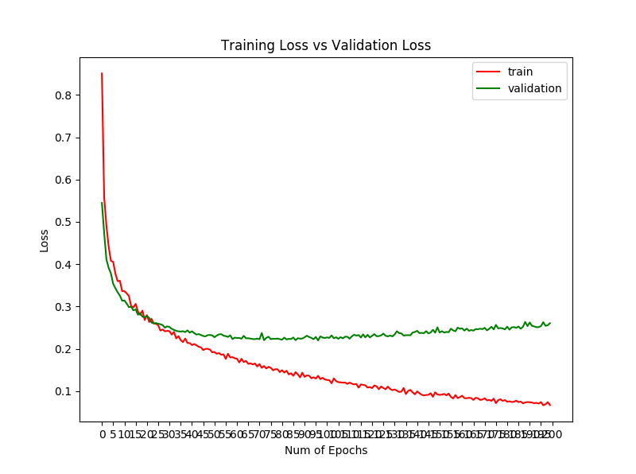
Overfit - learns training data too well

Slide 25
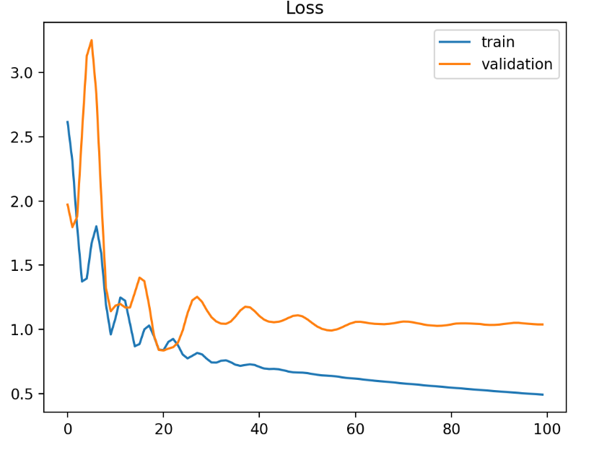
Unrepresentative training sets

Slide 26
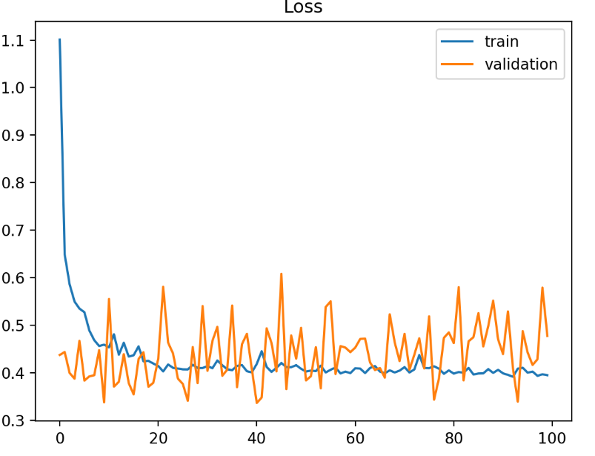
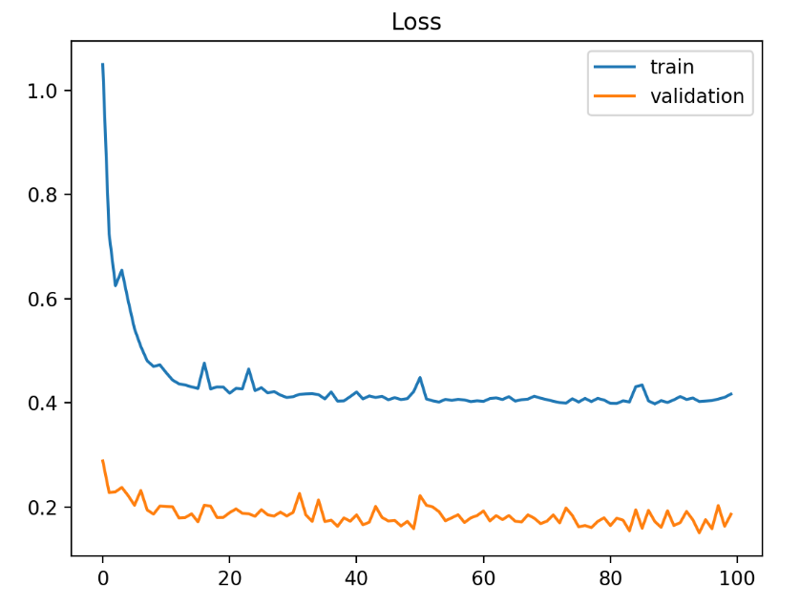
Unrepresentative validation sets

Slide 27
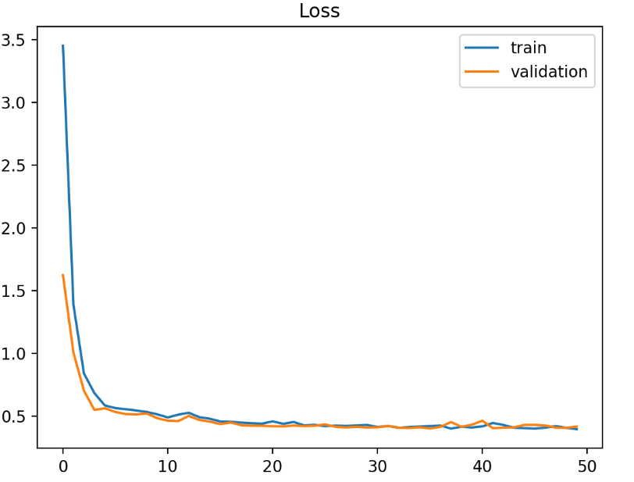
Good fit

Slide 28
How to optimize?
Grid Search Cross Validation
Random Search
Automated Hyperparameter tuning
Notes:
https://towardsdatascience.com/hyperparameters-optimization-526348bb8e2d

Slide 29
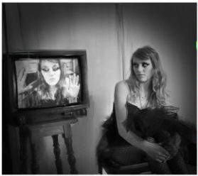
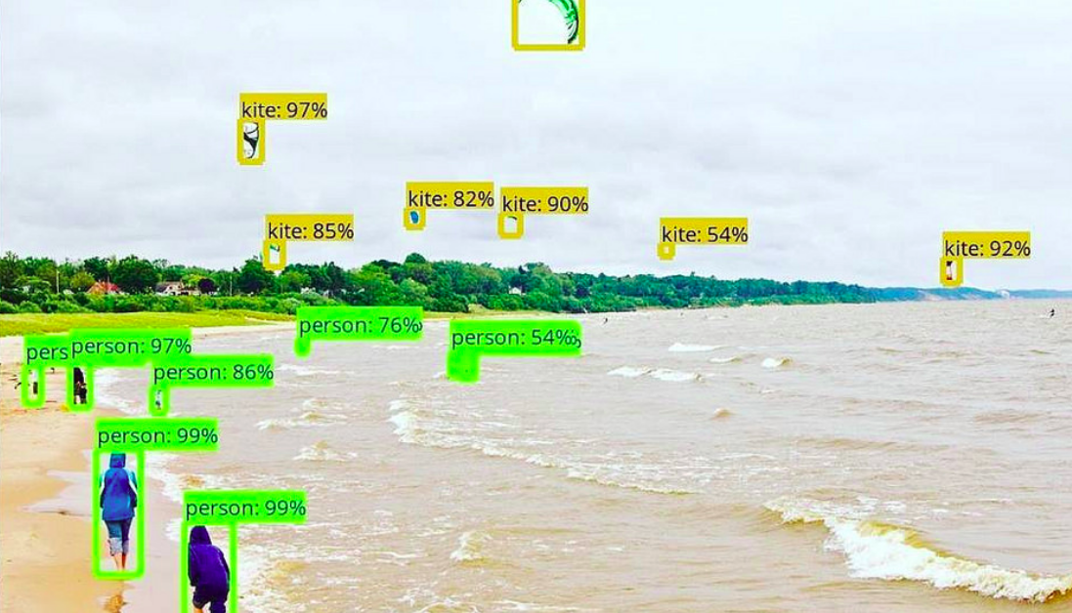
Object Detection
Image classification is good and all, but...
Notes:
https://www.analyticsvidhya.com/blog/2018/10/a-step-by-step-introduction-to-the-basic-object-detection-algorithms-part-1/

Slide 30
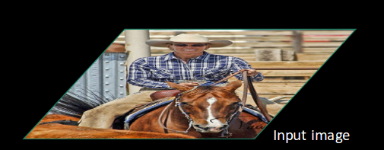
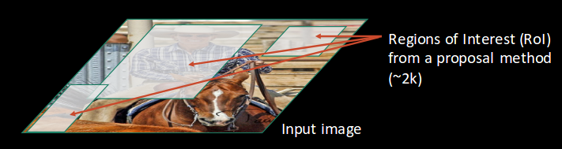
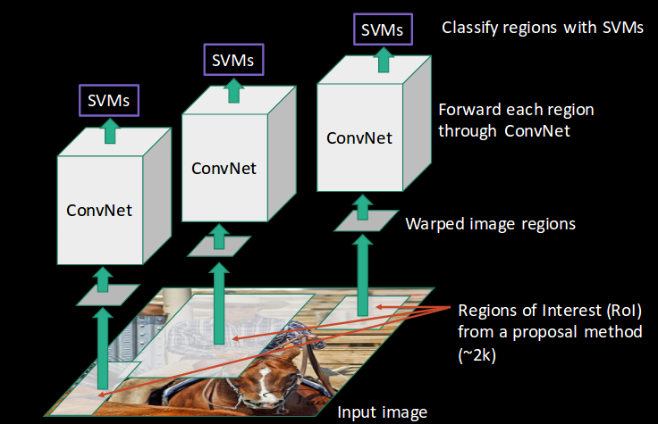
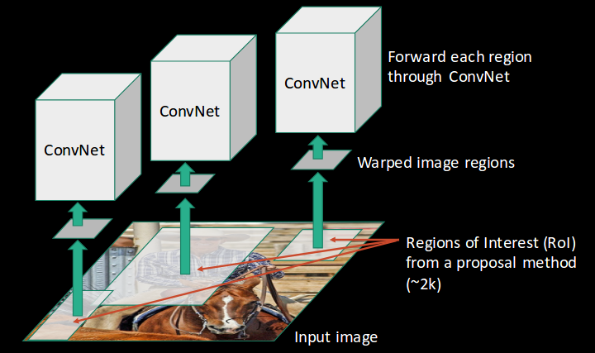

Slide 31
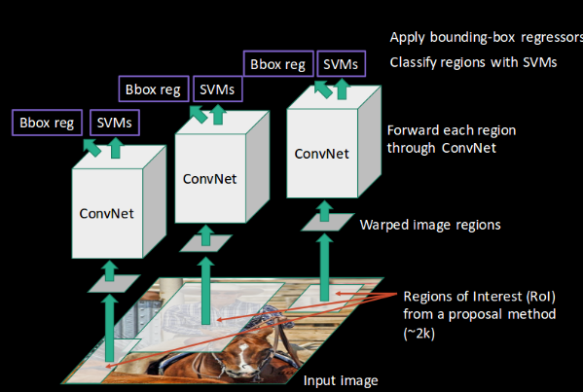
RCNN(Region-based Convolutional Neural Network):
Selective search for ROI(region of interest) proposal
CNN for feature map generation
Classification head(support vector machine) for image classification
Regression head(Linear regressor) for bounding box prediction
Long processing time: takes 40-50 seconds for a prediction to be made (need to pass ~2k images through the conv net)
Computationally expensive; need to train 3 separate models.
Can we do better?
Notes:
https://leonardoaraujosantos.gitbooks.io/artificial-inteligence/content/object_localization_and_detection.html

Slide 32
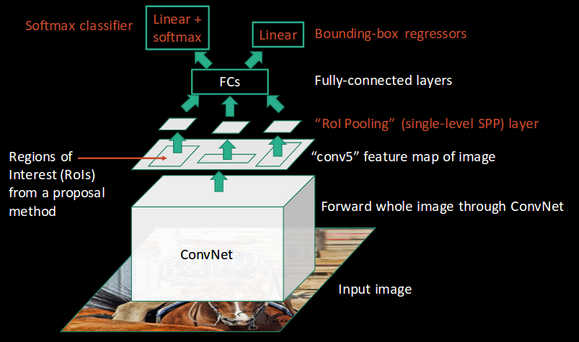
Fast RCNN:

Slide 33
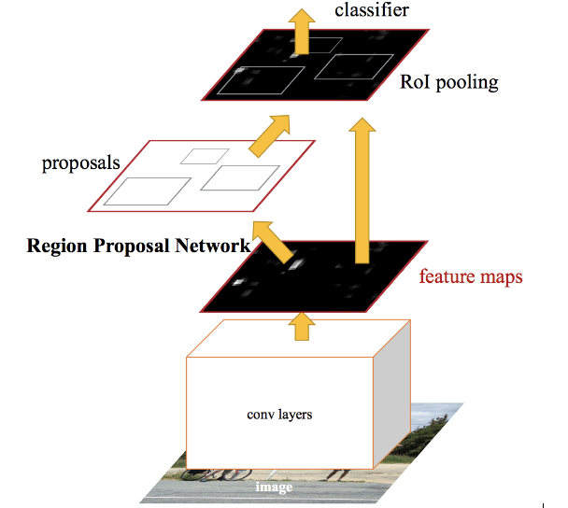
Faster RCNN:

Slide 34
Even faster still...YOLO and SSD???!!!
YOLO - You Only Look Once
SSD - Single Shot Detector
Combines classification and regression heads to predict BOTH at once

Slide 35
